Slide 1
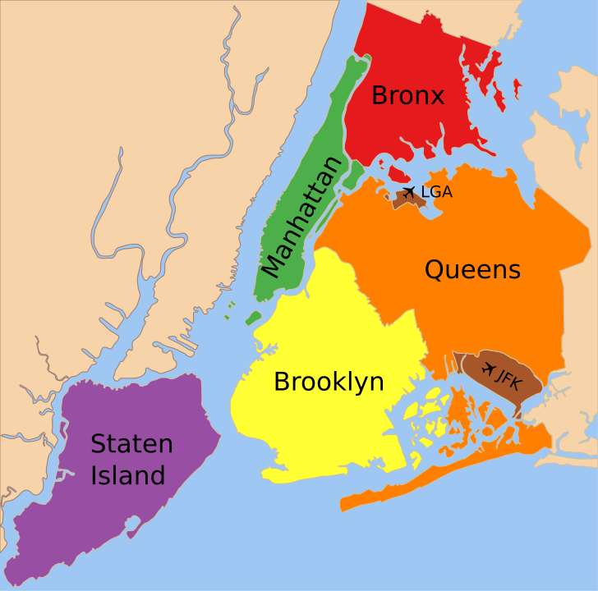
BROOKLYN REAL ESTATE PRICE PREDICTION
By Shreedhar Velmurugan
Bhuvanesh Chellapandian
Shanjanaa J
Sudharsan K
Aditya Ram B B

Slide 2
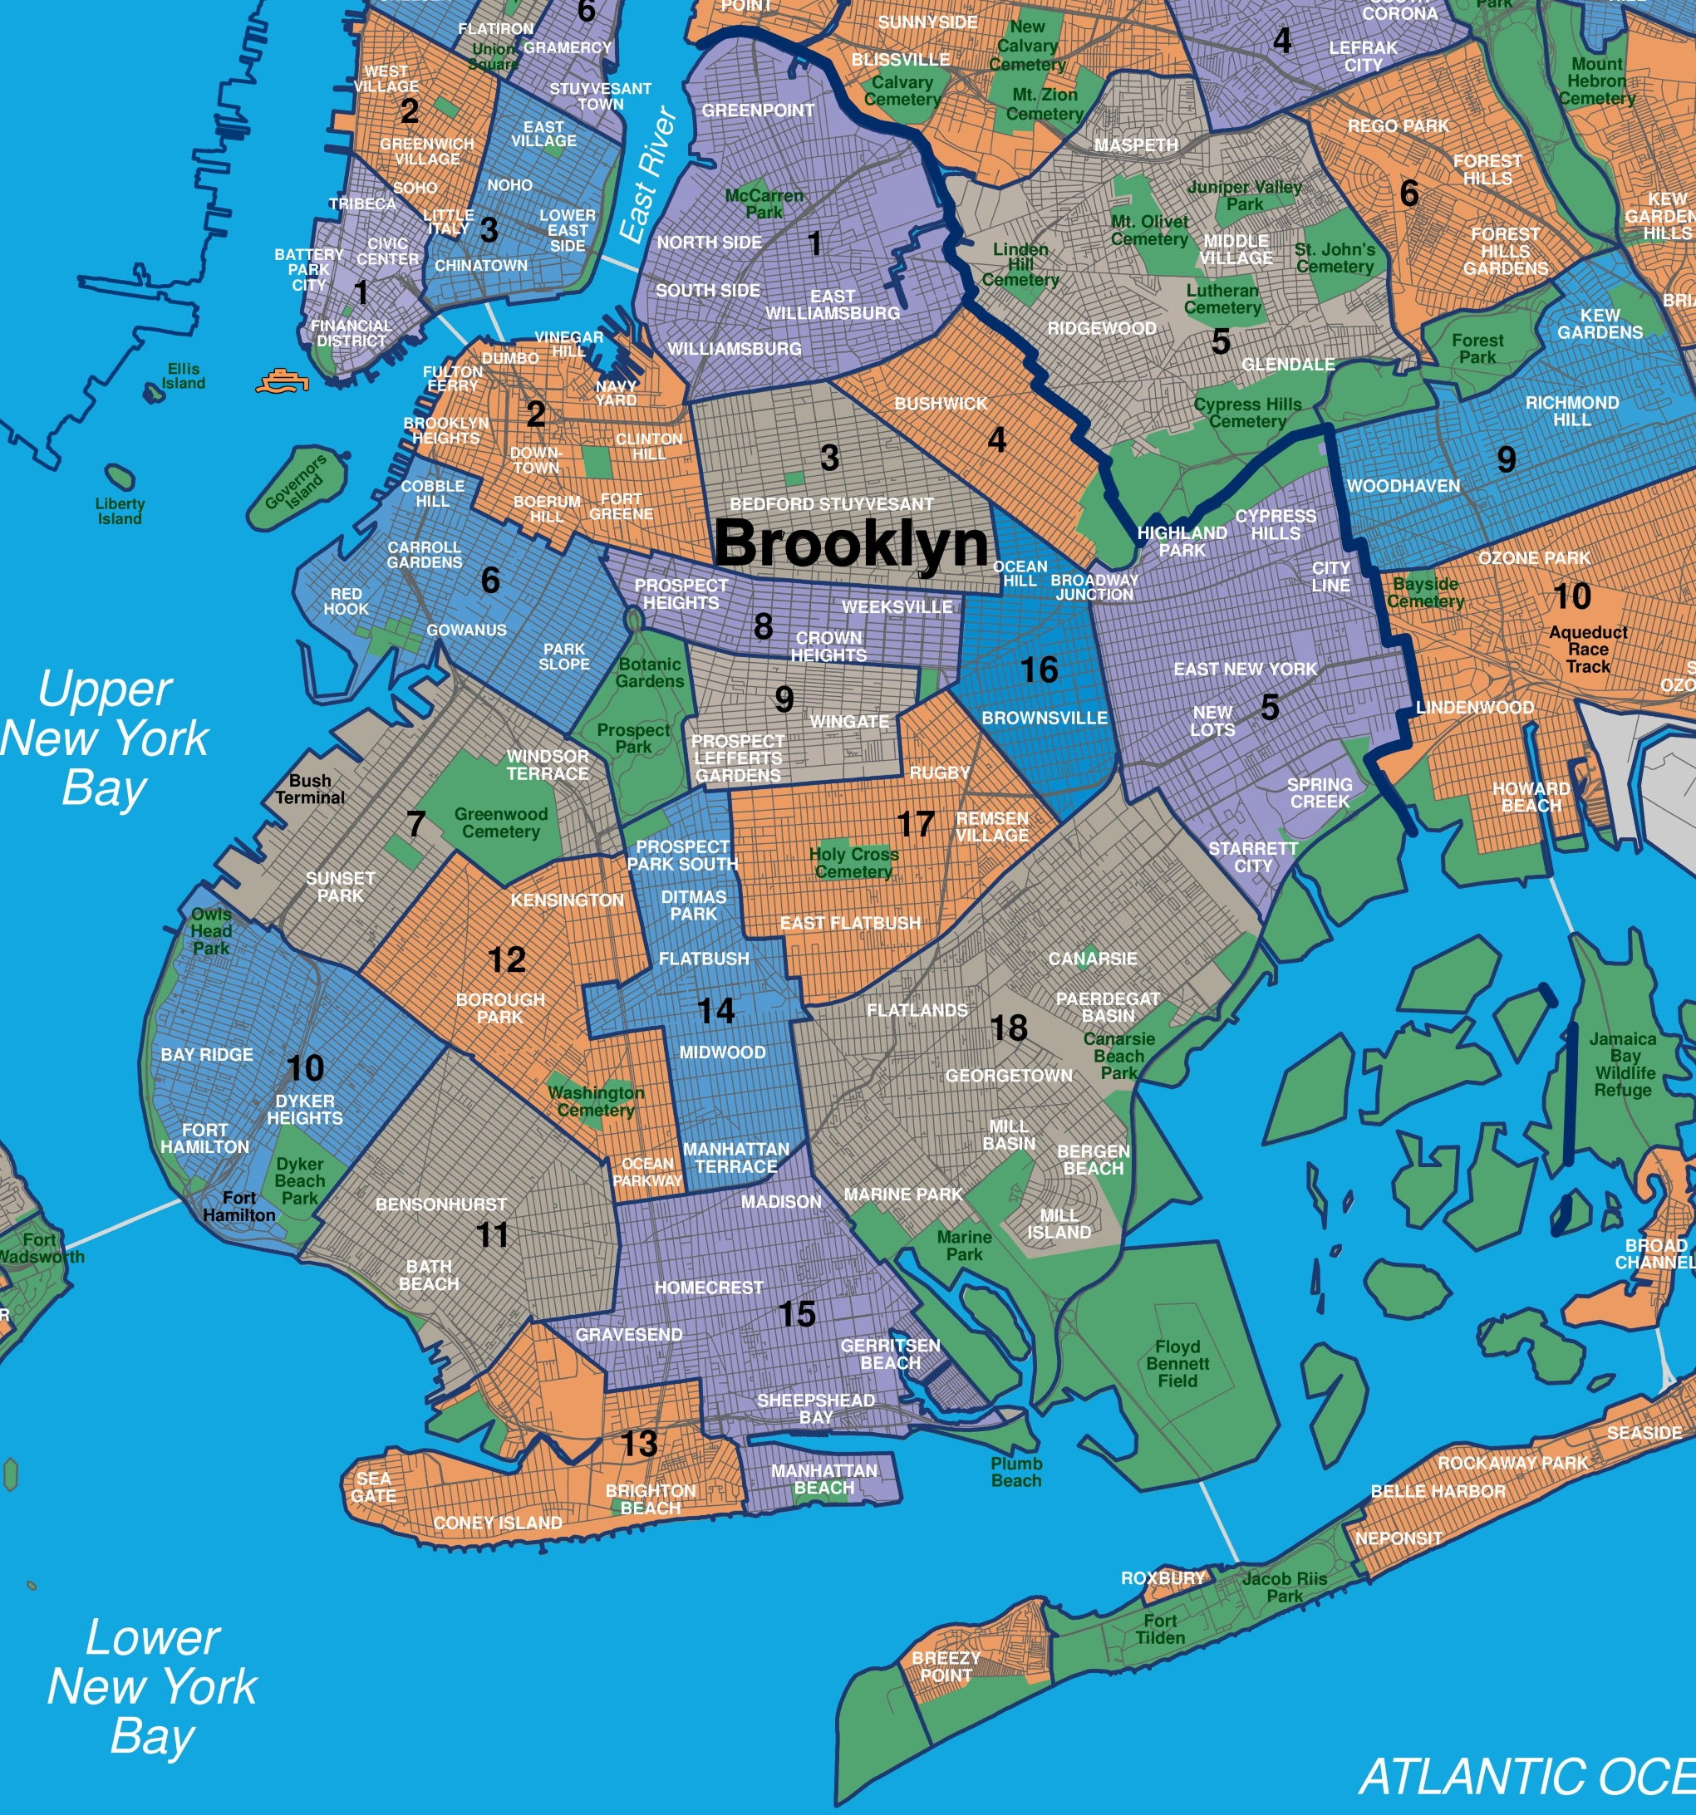
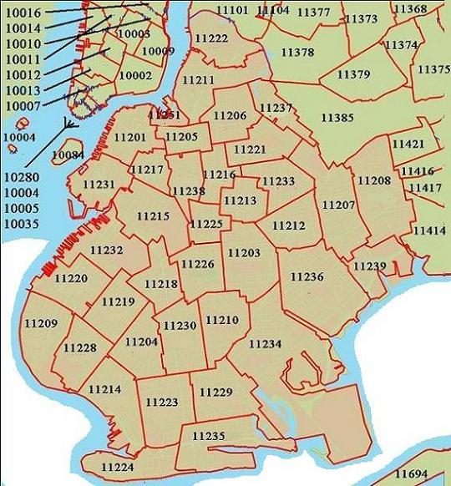
WELCOME TO BROOKLYN

Slide 3
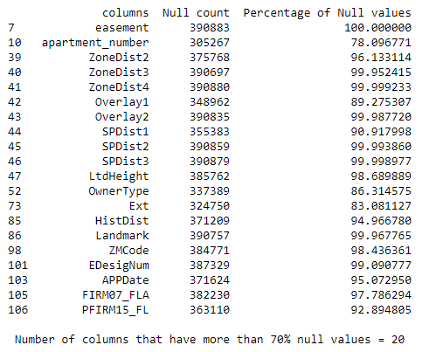
Total number of rows = 390883
Total number of columns = 111
Features with duplicates, low variance, high data imbalance, and are insignificant for price prediction – 60 columns
'CondoNo’
'SplitZone’
'residential_units’
'commercial_units’
'total_units’
'tax_class’
'SanitBoro’
'Address’
'BldgClass’
'tax_class_at_sale’
'AreaSource’
'OfficeArea’
'FactryArea’
'StrgeArea’
'GarageArea'
'RetailArea’
'Easements’
'YearBuilt’
'ZipCode’
'block’
'lot' 'address’
'zip_code’
'year_built’
'CD’
'Council’
'ZoneMap’
'UnitsRes’
'UnitsTotal’
'borough’
'Borough’
'Unnamed: 0’
'Version’
'PLUTOMapID’
'MAPPLUTO_F’
'APPBBL’
'TaxMap’
'Sanborn’
'Tract2010’
'BBL’
'BoroCode’
'CT2010’
'CB2010’
'FireComp’
'HealthArea’
'HealthCent’
'YCoord’
'XCoord’
'OwnerName’
'PolicePrct’
'building_class’
'SanitDistr’
'SanitSub’
'ZoneDist1’
'sale_date’
'ExemptTot’
'ExemptLand'
GIVEN INFORMATION
'''Note that as in other uploaded datasets of NYC housing on Kaggle, many of these transactions have a sale price of $0 or only a nominal amount far less than market value. These are likely property transfers to relatives and should be excluded from any analysis of market prices.'‘’
So we shall exclude all rows that have a sale price of 0 dollars or a sale price less than 1000 dollars.
By doing so we will reduce the number of rows in the dataset, which is unavoidable.

Slide 4
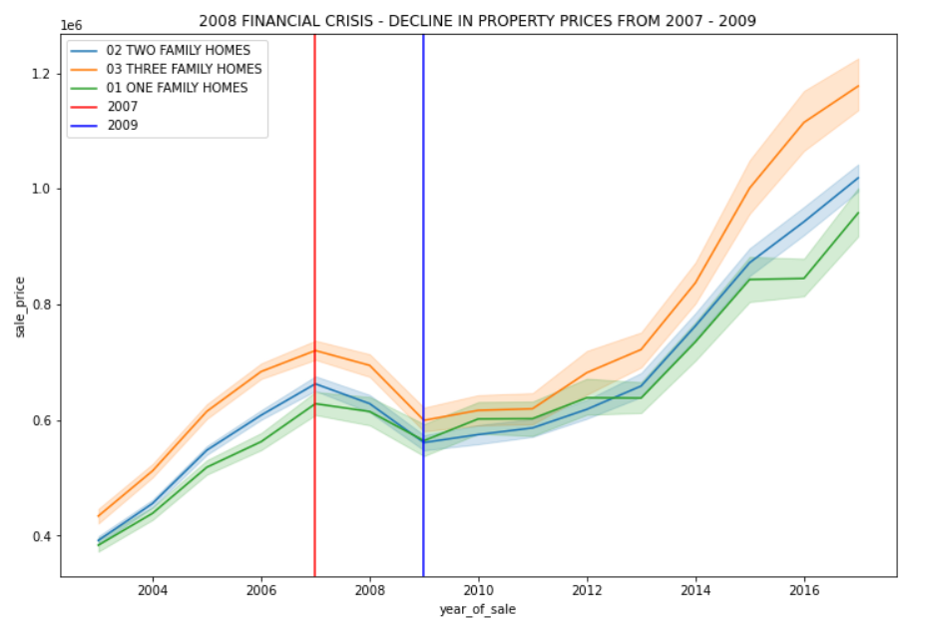
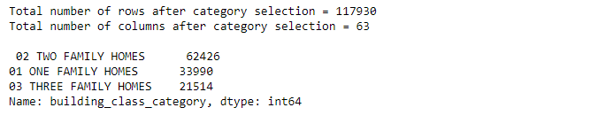
IMPORTANT DECISION
In Real Estate price prediction we cannot combine different categories(different asset classes) together and build a one size fits all model.
So we have to cut down to three categories and separate them afterward and perform EDA for each of the three categories.
Then we will build one model for each Property category.
This is possible because we have a good sample size for each category.
This is done to increase the performance of our model.
OUR three categories are
'ONE FAMILY HOME'
'TWO FAMILY HOME'
'THREE FAMILY HOME’
2008 Financial crisis
The financial crisis of 2008 created the biggest disruption to the U.S. housing market since the Great Depression
We can divide the real estate market trend into two categories. Before 2008 and after 2008
Considering the whole data from 2004 to 2016 for training (2017 as test set), our model performance will be greatly affected because we are trying to capture two different trends. Things have drastically changed after the 2008 financial crisis.
In order to solve this, we will be considering the sales that took place after 2008. This will lead to the concept of trying to build a model that will capture the new trend that was formed after 2008.

Slide 5
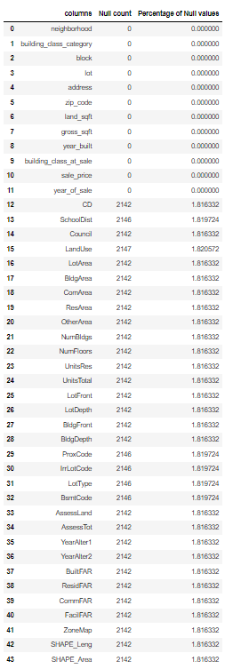
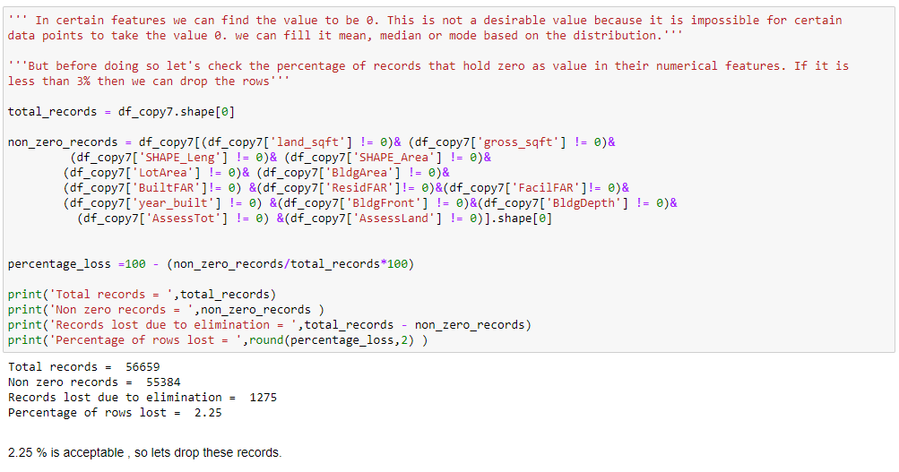
NULL VALUE TREATMENT
Since the percentage of Null values is less than 2% we can drop them.
We do not want to inject bias into our dataset. (filling with mean, median or mode will inject bias into our dataset)

Slide 6
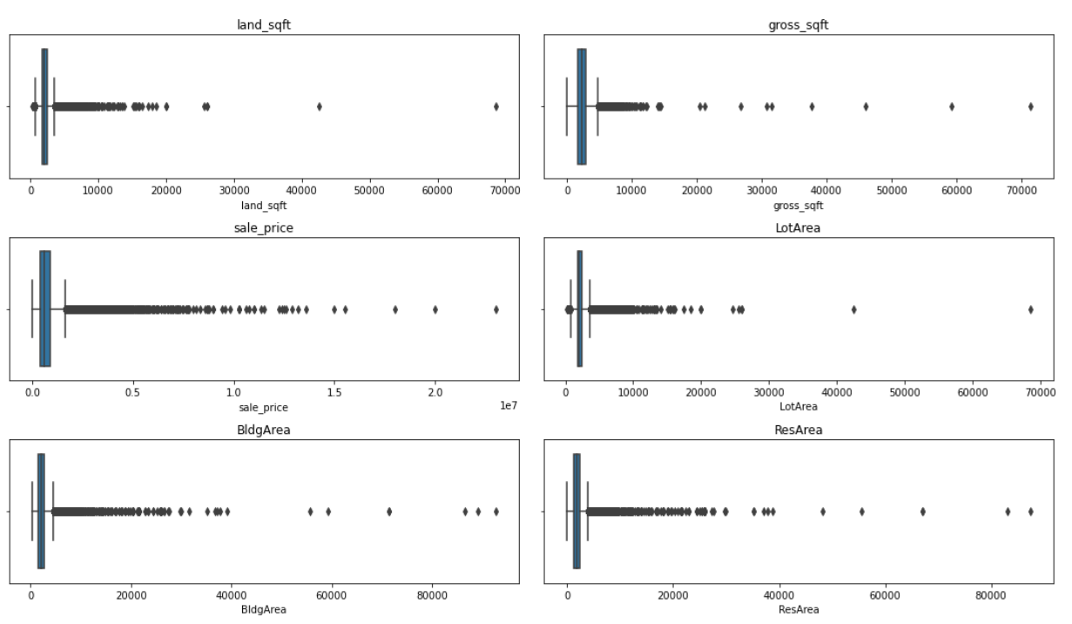
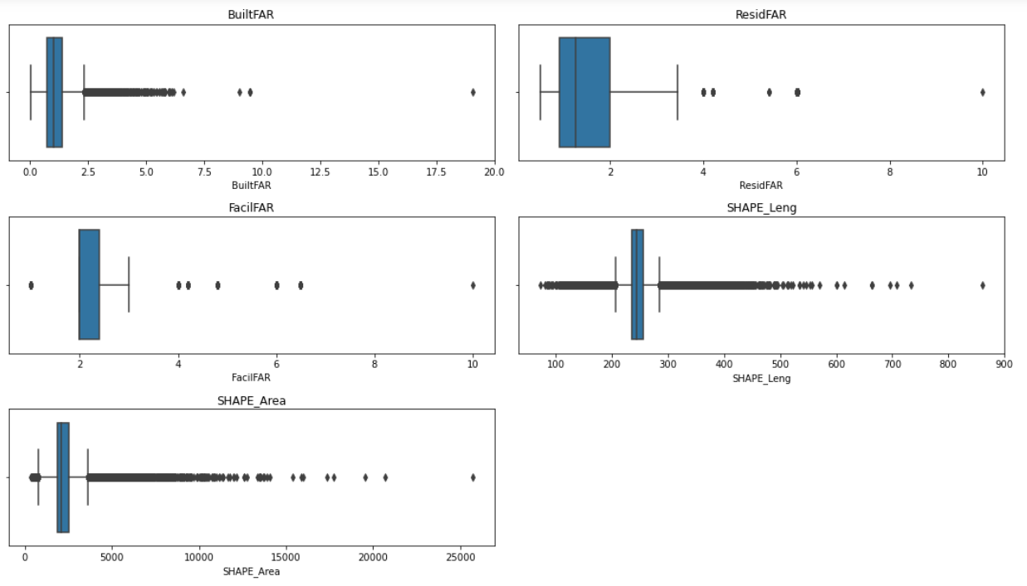
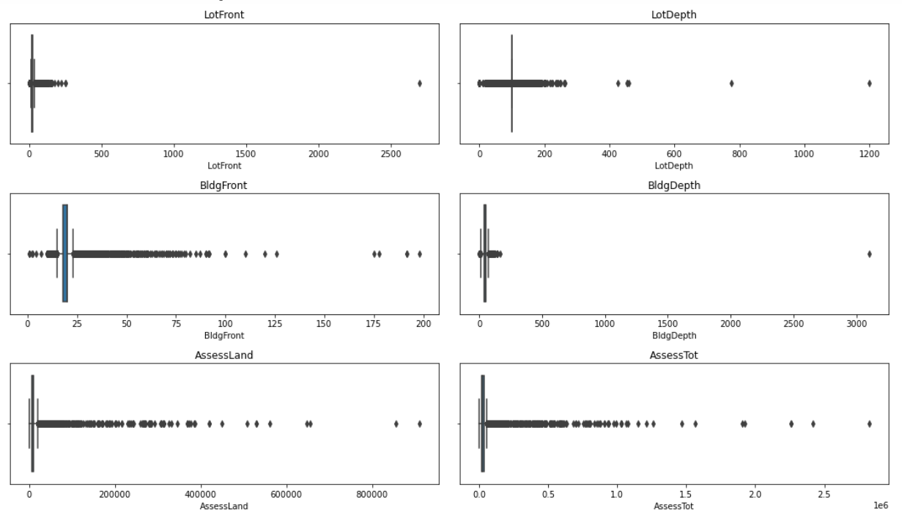
OUTLIER
VISUALIZATION
observations on outliers
'land_sqft’: There are 5 values above 23000.
'gross_sqft’: There are 6 values above 30000.
'sale_price’: There are 5 values above 15000000.
'LotArea’: There are 6 values above 21000.
'BldgArea’: There are 7 values above 50000.
'ResArea’: There are 6 values above 40000.
'LotFront’: There are 4 values above 200.
'LotDepth’: There are 6 values above 270.
'BldgFront’: There are 5 values above 126.
'BldgDepth’: There is 1 value above 165.
'AssessLand’: There are 8 values above 509000.
'AssessTot’: There are 6 values above 1600000.
'BuiltFAR’: There are 6 values above 7.
'ResidFAR’: There is 1 value above 6.2.
'FacilFAR’: There is 1 value above 6.5.
'SHAPE_Leng’: There is 1 value above 800.
'SHAPE_Area’: There are 8 values above 15000.

Slide 7
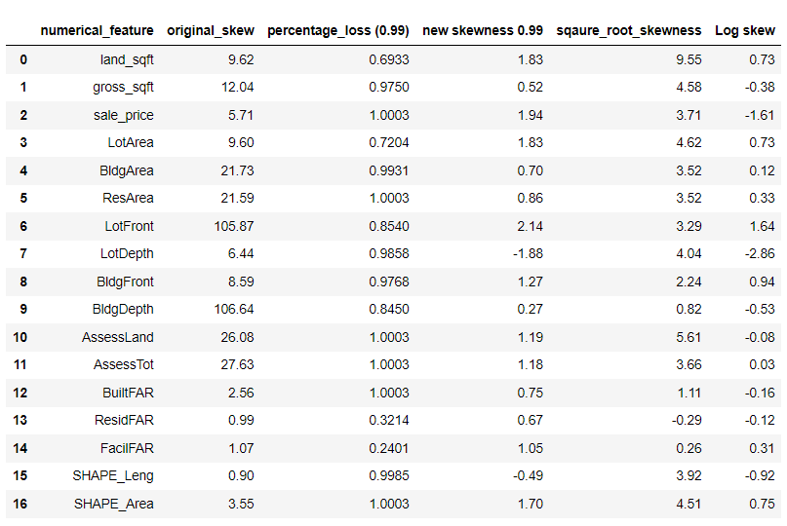
SKEW TABLE
Number of records removed before performing log transform = 60

Slide 8
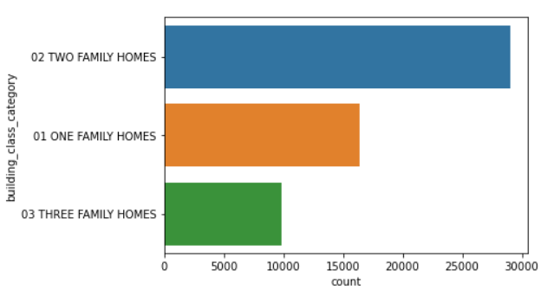
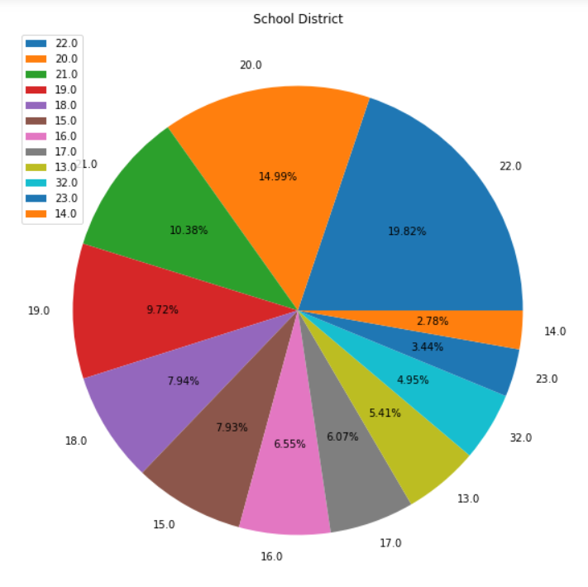
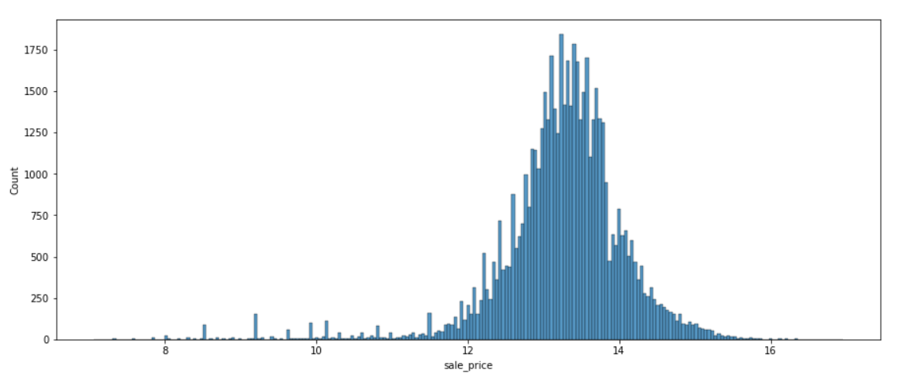
EXPLORATORY DATA ANALYSIS
There are many subcategories in the School district feature.
Similarly, we can find multiple subcategories in other categories.
The target column sale price is normally distributed.

Slide 9
FEATURE ENGINEERING:
List of new features that were created:
Two features 'YearAlter1' and 'YearAlter2' were converted into a single feature.
Using 'year_built' and 'year_of_sale' features, the age feature was created.
All years in the year category were replaced with numbers in ascending order.
All data points in the ‘SchoolDist’ column were replaced with alphabets.
All data points in the ‘LandUse’ column were replaced with their respective details.
All data points in the ‘ProxCode’ column were replaced with their respective details.
All data points in the ‘LotType’ column were replaced with their respective details.
All data points in the ‘BsmtCode’ column were replaced with their respective details.
List of new features created using clustering Algorithm:
To reduce the number of columns after encoding, we have to take care of the subcategories in features that have a large number of subcategories. A single numerical feature was used to create 5 numerical features and clustering algorithm was applied on them.
'neighbor_clusters'
'bclass_clusters'
‘landuse_group'
'school'
'Lot'
These features contain cluster groups of their respective original features.

Slide 10
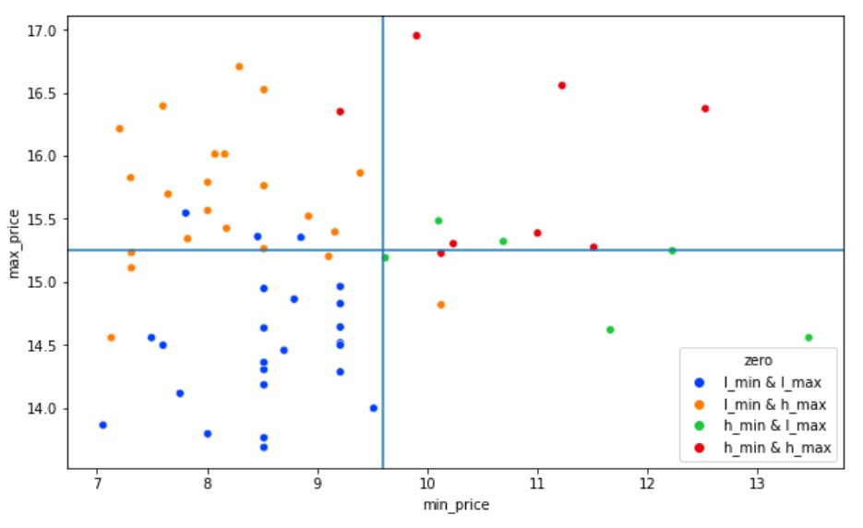
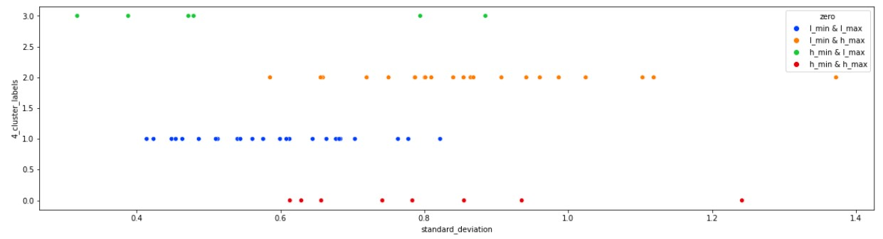
Neighborhood cluster:
'''Low minimum price and low maximum price'''
‘l_min & l_max’: They were low priced in the past and still they are at a low price range (low deviation)
'''Low minimum price and high maximum price'''
‘l_min & h_max’: They were low priced in the past but later they moved to a premium price range (good deviation) (good growth)
'''High minimum price and low maximum price '''
‘h_min & l_max’: They were premium priced in the past and but they did not experience any relative growth (low deviation)
'''High minimum price and high maximum price'''
‘h_min & h_max’: They were premium priced in the past and still they are maintaining their premium level (good deviation)

Slide 11
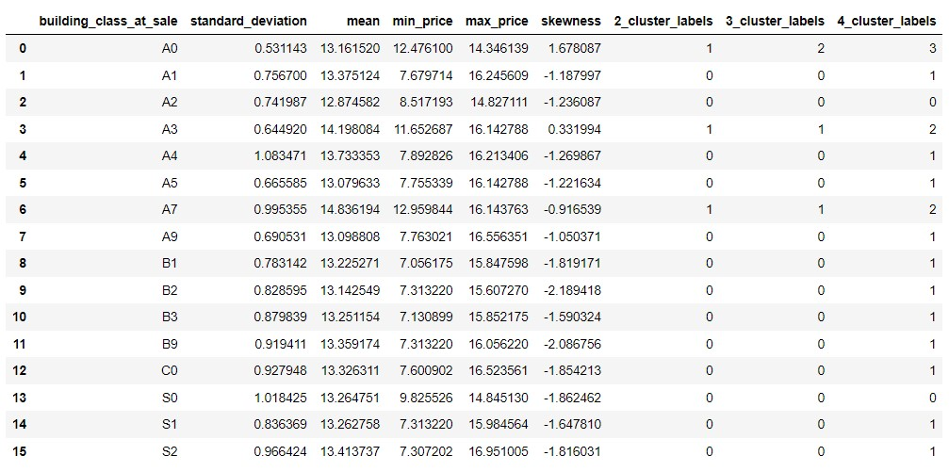
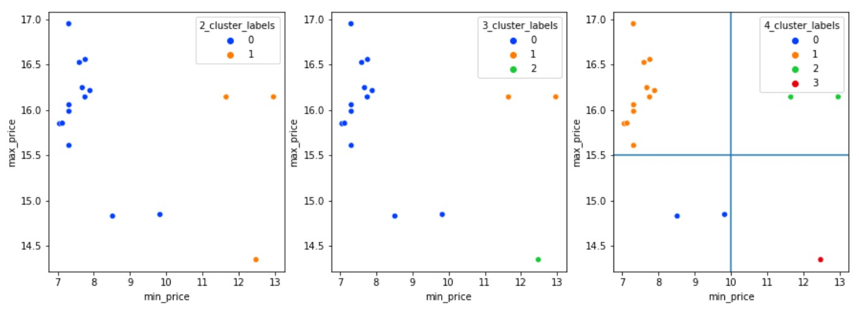
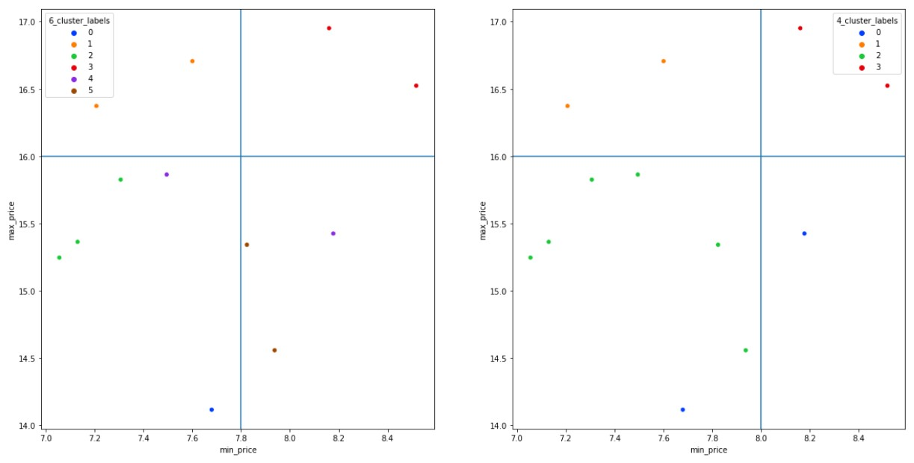
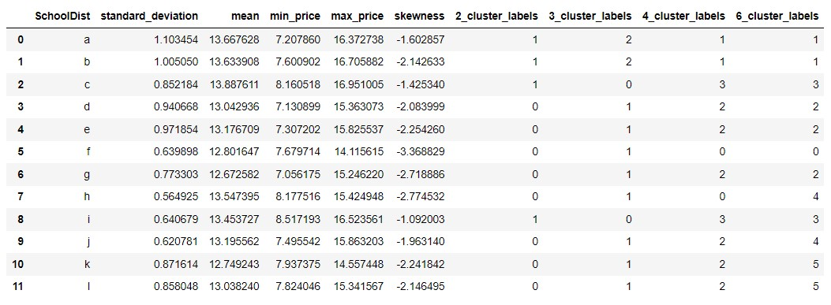
Business class during sale cluster:
School district cluster:

Slide 12
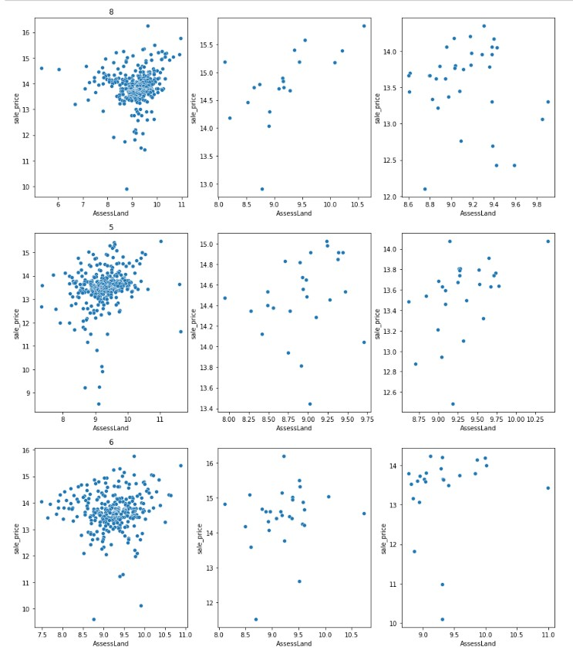
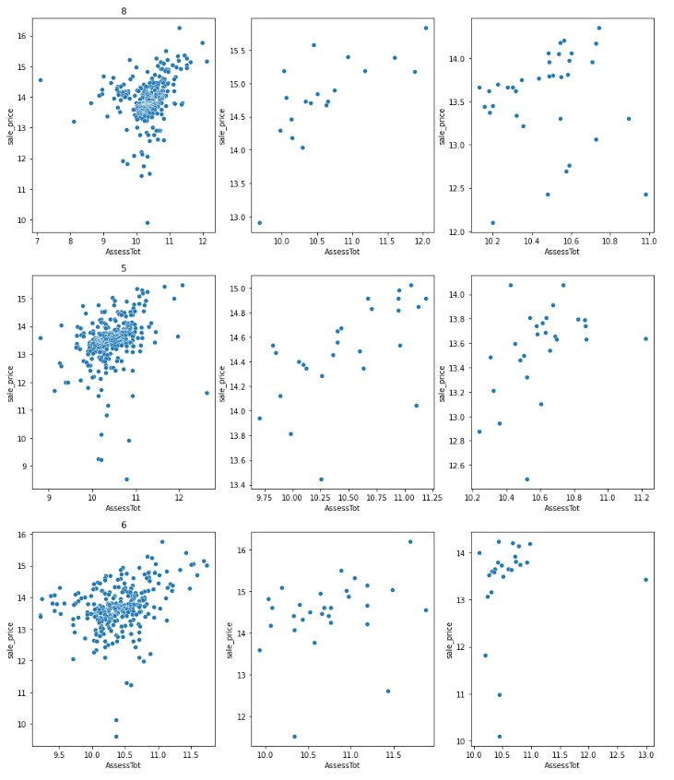
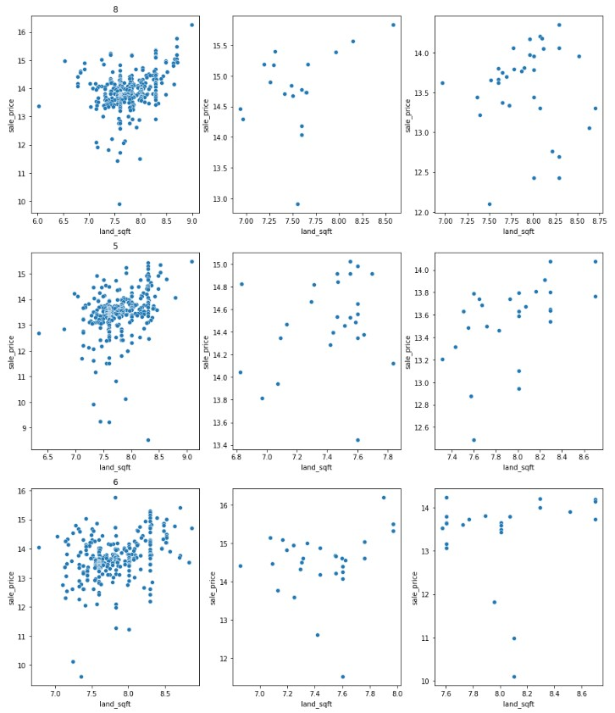
Column 1: 'low_min_high_max_neighborhood', School group 3 ,2 Basements
Column 2: 'high_min_high_max_neighborhood', School group 3, 2 Basements
Column 3: 'high_min_low_max_neighborhood' School group 3, 2 Basements
The sale price in the first column is clustered around a certain region and the regions move every year.
The sale price in the second seems to be positively correlated to the AssessTot.
The sale price in the third column has a weak positive correlation to AssessTot.
The sale price in the first column is clustered around a certain region and the regions move very year.
The sale price in the second seems to be positively correlated to the land_sqft.
The sale price in the third column has a weak positive correlation to land_sqft.

Slide 13
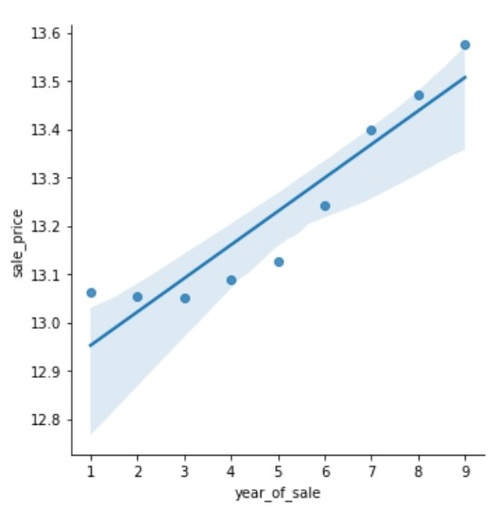
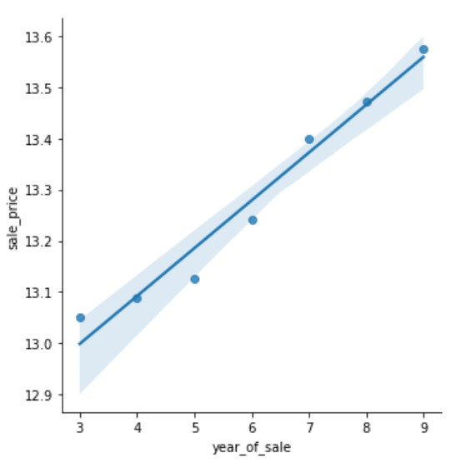
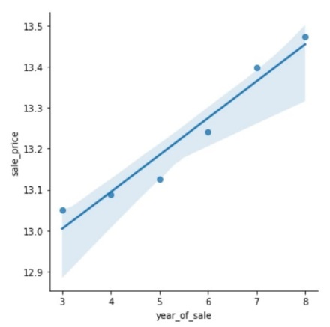
Inference:
Plot 1 – For the first three years, the price increase is negligible.
Plot 2 – From the 3rd year, there is a steady increase in average sale price.
Plot 3 – When we use a linear model plot we can observe that the regression line is able to roughly estimate the 9th year’s average price.

Slide 14
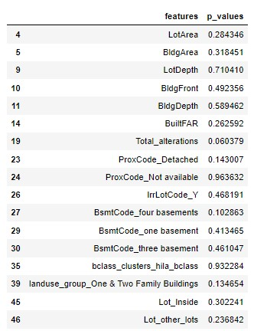
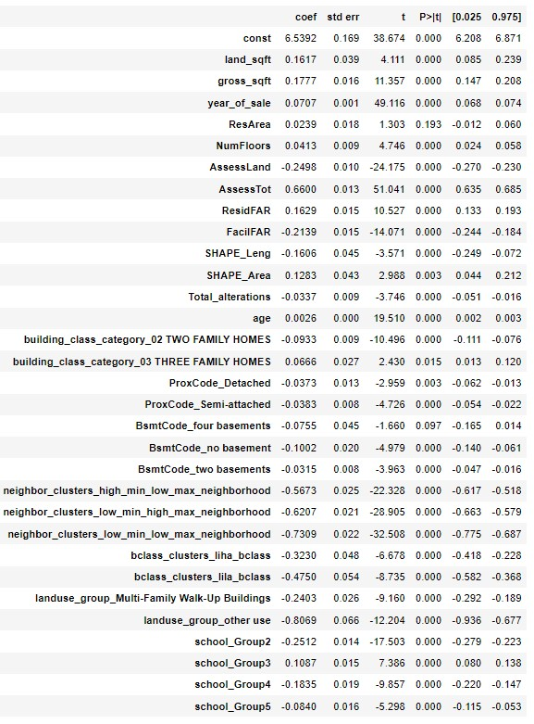
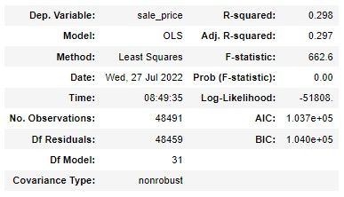
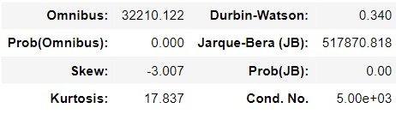
BASE MODEL
NOTE: Before building this model, a primary OLS model was built and features having p-values greater than 0.05 were removed

Slide 15
Inference from the OLS model:
AssessTot, year of sale, low_min_low_max_neighborhood, low_min_high_max_neighborhood, AssessLand, high_min_low_max neighborhood, and age are features that contribute more to the sale price.
Let’s analyze the school group columns:
When a property is present in School_Group3 it experiences a 10.87% price variation on average.
When a property is present in School_Group2 it experiences a -25.12% price variation on average.
When a property is present in School_Group4 it experiences a -18.35% price variation on average.
When a property is present in School_Group5 it experiences a -8.40% price variation on average.
In other words, we could say that with respect to School_Group1 School_Group3 is valued more while other School groups are valued lower.
Due to n-1 encoding the value of the first school group is fused into the constant term and whenever a property falls in any neighborhood category the linear equation balances it by making the coefficient of other terms negative or positive based on its value.
Let’s analyze the neighborhood features.
When a property is present in high_min_low_max_neighborhood it experiences a -56.73% price variation on average.
When a property is present in low_min_high_max_neighborhood it experiences a -62.07% price variation on average.
When a property is present in low_min_low_max_neighborhood it experiences a -73.09% price variation on average.
In other words, we could say that with respect to high_min_high_max_neighborhood all other neighbourhoods are undervalued.
Due to n-1 encoding the value of the high_min_high_max_neighborhood is fused into constant term and whenever a property falls in any other neighbourhood category the linear equation balances it by making the coefficient of other terms negative.

Slide 16
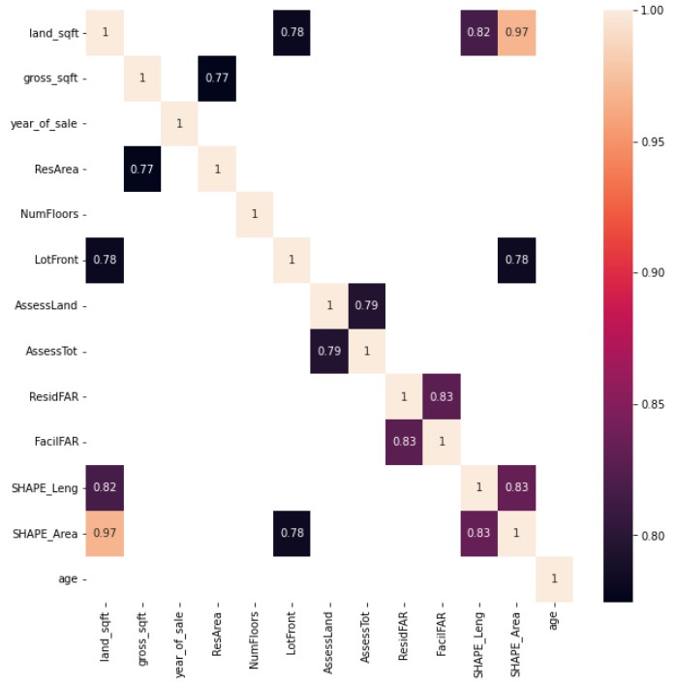
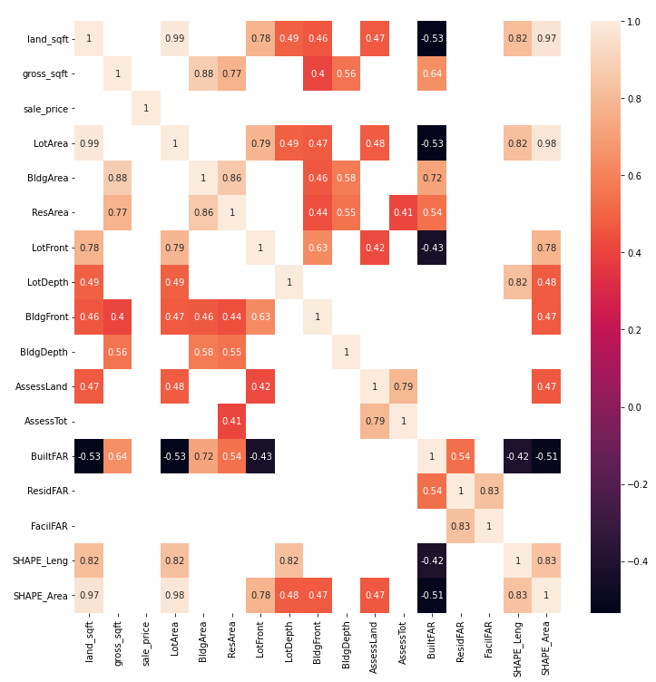
Multi–collinearity Detection
Threshold: 0.7
Threshold: 0.4

Slide 17
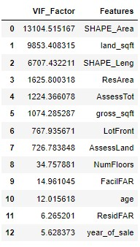
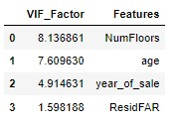
VARIANCE INFLATION FACTOR:
After multiple iterations, we end up with 4 columns from 13 columns that have a VIF value lesser than 10.

Slide 18
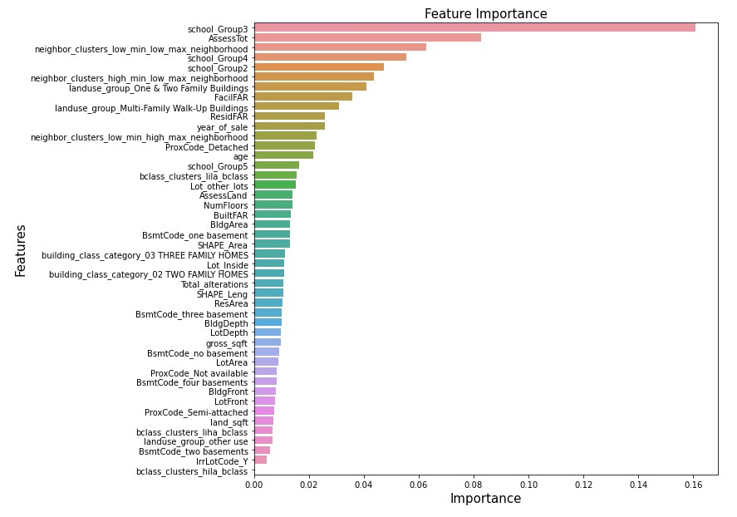
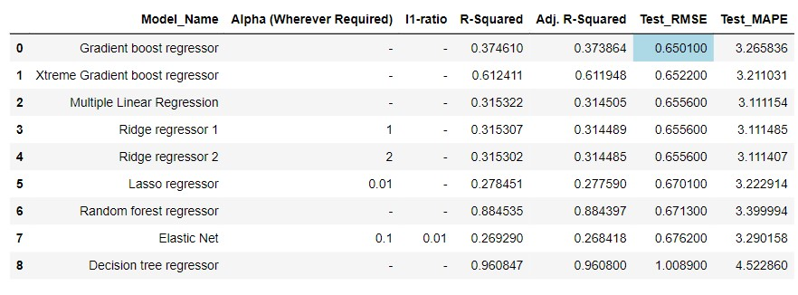
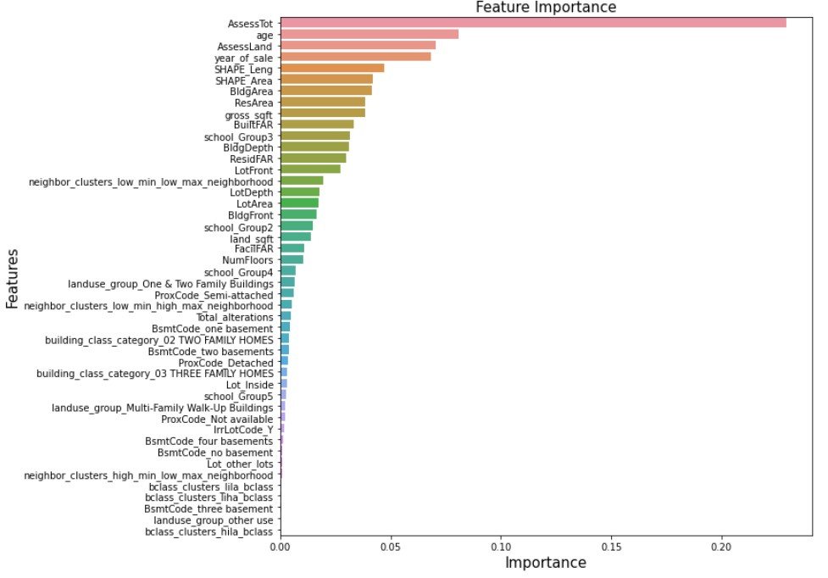
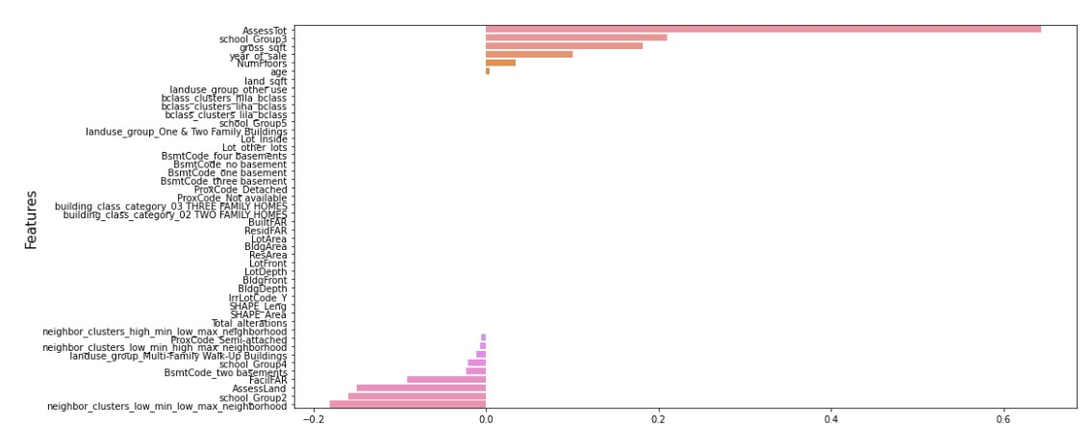
Xtreme Gradient Boosting Algorithm feature importance:
SCORECARD
Random Forest Regressor Algorithm feature importance:
Lasso regularization Algorithm feature coefficients :

Slide 19
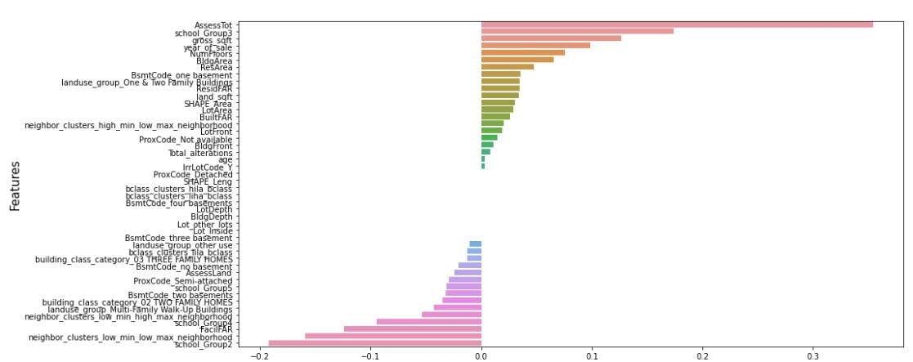
Elastic net regularization Algorithm feature coefficients:
Inference: we can observe that many feature coefficients become 0 when we use Lasso regularization and when we use Elastic net fewer feature coefficients become 0
HYPERPARAMETER TUNING:
Carried out hyperparameter tuning with Random Forest Regressor and Xtreme Gradient Boost Regressor.
Best parameters for random forest Regressor:
criterion: squared error
max depth: 10
max features: square root
max leaf nodes: 11
min samples leaf: 1
min samples split: 5
n estimators: 90
Best parameters for XGBoost classifier: gamma: 3
Learning rate: 0.1
max depth: 3

Slide 20
Implications and Inference:
From executing different algorithms, we can observe that a small group of features is given more weightage in all the above algorithms.
It’s also common knowledge to know that price of properties will increase with time.
Apart from that, features like School group 3, age, assessed total value, assessed land value, number of floors in a building, gross square foot, and neighborhood clusters are very important and play a key role in determining the price of a property.
Closing Reflections:
We have learned that we have to separate the data again based on different regions and other features and multiple small models have to be built to increase the prediction accuracy.

Slide 21
THANK YOU

